Slide 1



PTNP for PBM Stakeholders
Pharmacy Network Adequacy
Tonmoy Dasgupta
January 9, 2026,
Regulatory Health Link Division,
Arkansas Insurance Dept., Dept. of Commerce

Slide 2
The PTNP
What?
Who?
Why?
Where?
How?
When?

Slide 3
The PTNP
What?
Who?
Why?
Where?
How?
When?

Slide 4
What?...is the PTNP? Who?...are involved?
The PTNP is the latest industry consensus on provider classifications. Arrival at this consensus is facilitated by AID.
  The acronym PTNP stands for Provider Type NPI Pools. Think of it as pools of providers assigned to provider types regulated by AID.
This consensus is housed within a spreadsheet published by AID labelled as Current Finalized Provider Type-NPI Pool and referred to as the PTNP for brevity.
The PTNP is updated twice a year through the “PTNP Process”

Slide 5
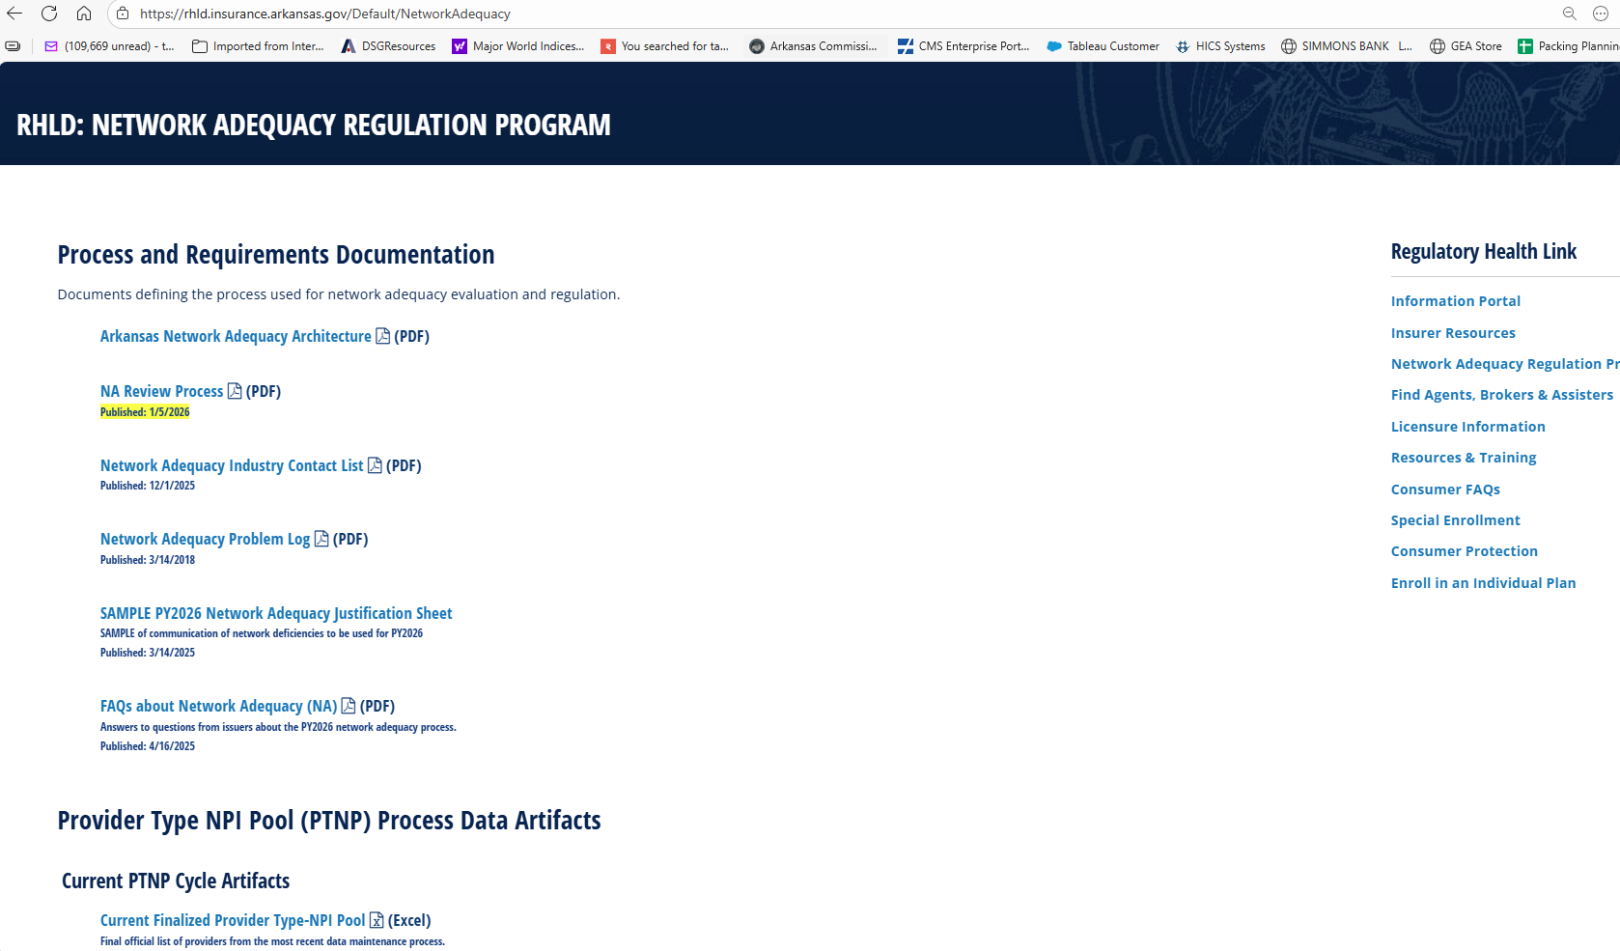
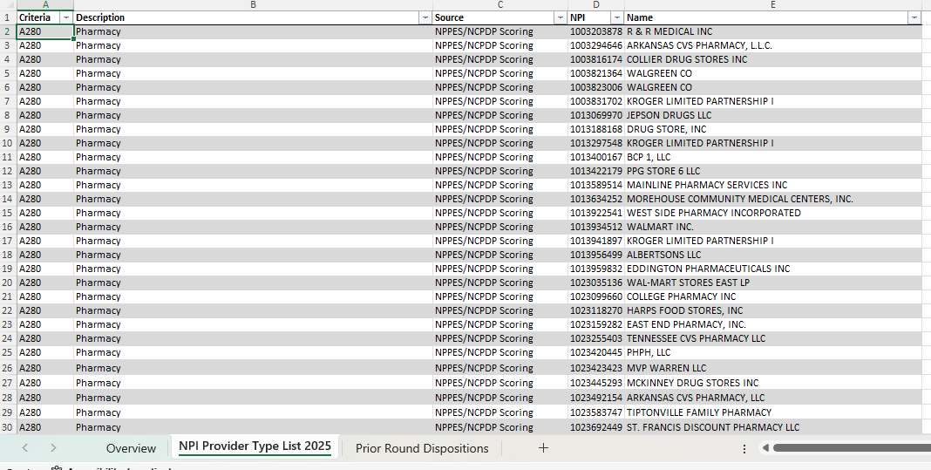
3 tabs
The PTNP

Slide 6
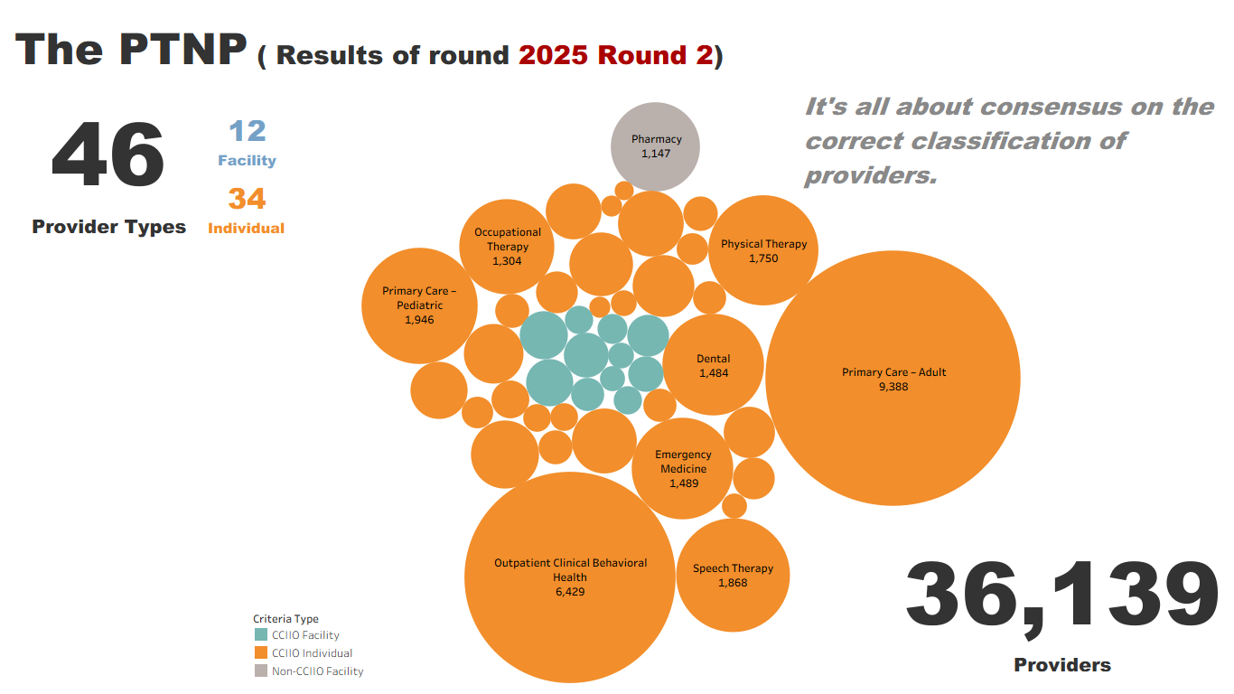

Slide 7
What? (cont’d)
Provider Types are defined in terms NUCC Taxonomy codes.
This definition document is published as a spreadsheet called Provider Type Taxonomic Descriptions (located at https://rhld.insurance.arkansas.gov/NetworkAdequacy).
The definition for Pharmacy has the following but it must vetted as a “Community/Retail Pharmacy”
Taxonomy | Taxonomy Description
333600000X | Pharmacy
3336C0003X | Community / Retail Pharmacy

Slide 8
What? (cont’d)
“But… What’s in it for me?”
Starting in 2026, only pharmacies existing in the PTNP will used in network adequacy computations as retail pharmacies. For example, if an issuer reports 2000 pharmacies in the PLN table in 2026 but the PTNP has 1147 pharmacies, only those among the 2000 pharmacies that exist in the PTNP will get credit as retail pharmacies towards network adequacy computations.
“So… only worry about retail pharmacy additions? Not removals of incorrect pharmacy types?”
Not quite. Let's understand how Arkansas issues objections.

Slide 9
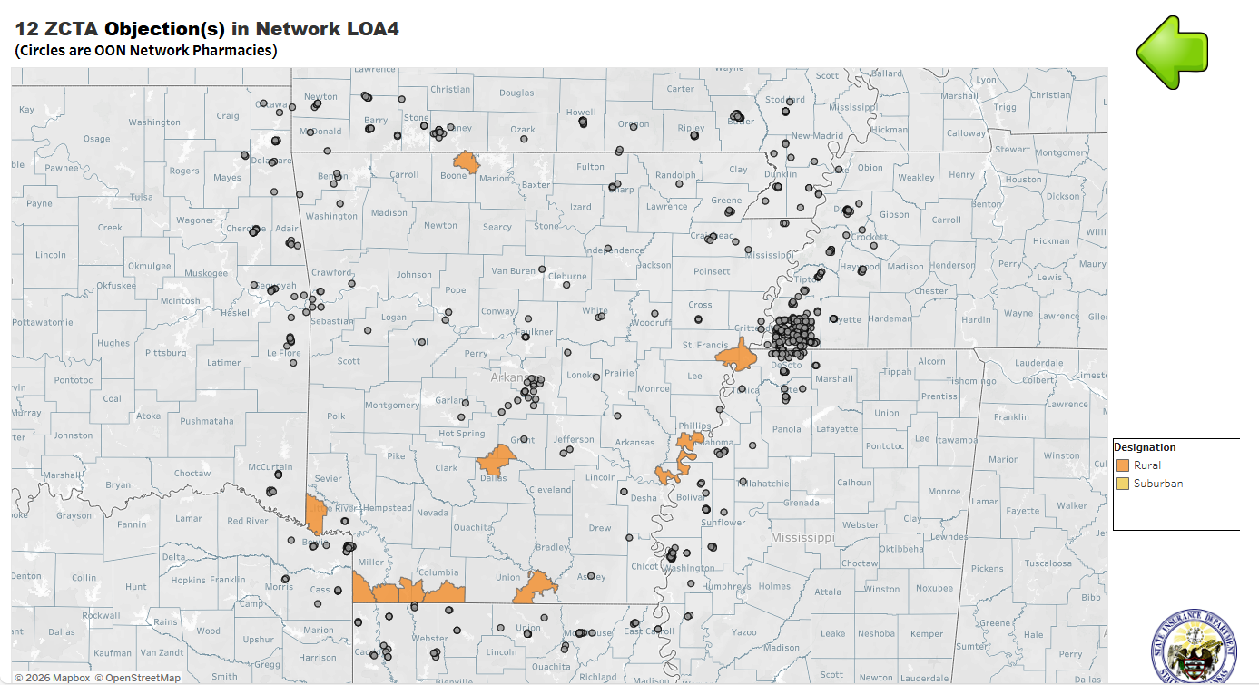
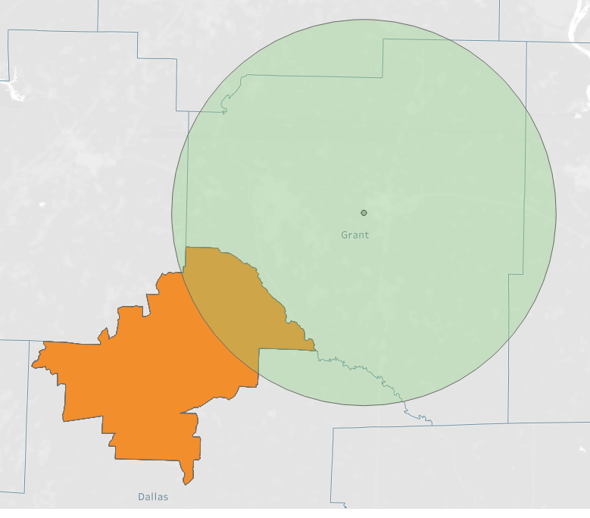
Issuer/PBM “ There aren’t any pharmacies close to our deficiencies “
First question to ask:
“Is this even a retail pharmacy?”
15 miles
Rural ZCTA

Slide 10
What? (cont’d)
AID issues objections for network deficiencies only when both conditions are met
  An issuer is deficient per statutory requirements in a ZCTA and
  Competitive data shows improvement is possible.
Ideal Pharmacy Network:
Deficiencies of each network is compared against an “ideal pharmacy network” built by aggregating pharmacies reported by all issuers that exist in the PTNP.
Reason to remove incorrect classifications:
  Consider the case when A) the PTNP has a non-retail pharmacy near your deficiency AND B) some issuer(s) reported the same pharmacy in their PLN table.
  This would make those issuer(s) network look erroneously stronger.
  This would result in an objection because your deficiency shows scope for improvement.
  Your justification in this case should be a commitment to remove the non-retail pharmacy in the next round of the PTNP process.
Once removed from the PTNP, no one gets credit for the invalid pharmacy type.
Bottomline: Keep the PTNP clean and representing only the truth!

Slide 11
The PTNP
  What?
  Who?
  Why?
  Where?
  How?
  When?

Slide 12
Why?...engage in the PTNP process?
The PTNP provider classification governance process was born in 2015, when industry thought leaders and AID realized that without a common understanding of the classification of providers, evidence-based objective regulation was not possible.
  The NPPES (NPI Registry) classification data was not deemed accurate enough.
In 2024-25, retail community pharmacies did not exist in the PTNP. AID sought to rely on NCPDP retail classifications, based on their reputation as the industry standard. However, some AID objections were contested, and it surfaced that NCPDP retail classifications were not accurate enough (just as with NPPES classifications in the past). This was validated by the Department contacting hundreds of pharmacies determining their retail classification.
Subsequently for 2026 onwards, it was decided to bring retail/community pharmacies back into the PTNP process for more accuracy and ensuring that all issuers/PBM were measured against the same understanding of community/retail pharmacies.

Slide 13
Why? (cont’d)
“Let perfection not be the enemy of the good”
– One of the guiding principles in AID’s Network Adequacy Architecture document.
The PTNP may not be 100% perfect. That is not the goal.
The goal is to be
  BETTER than the NCPDP or NPPES.
  BETTER every round.
  BETTER every year.
BETTER is good.

Slide 14
The PTNP
  What?
  Who?
  Why?
  Where?
  How?
  When?

Slide 15
Where?...do I locate the PTNP artifacts?
While most PBM pharmacy network adequacy related materials are in the webpage https://rhld.insurance.arkansas.gov/PBMRegulation the PTNP artifacts located in the overarching Network Adequacy Regulation Program homepage https://rhld.insurance.arkansas.gov/NetworkAdequacy .
Provider Type NPI Pool (PTNP) Process Data Artifacts:
  Current Finalized Provider Type-NPI Pool (aka the PTNP)
  <YYYY> Round <N> Initial Provider Type-NPI Pool Template
    For example: 2026 Round 1 Initial Provider Type-NPI Pool Template
  <YYYY> Round <N> Industry Provider Type Addition/Deletion suggestions Template
    For example: 2026 Round 1 Industry Provider Type Addition/Deletion suggestions Template

Slide 16
The PTNP
  What?
  Who?
  Why?
  Where?
  How?
  When?

Slide 17
How? … does the process work?
The PBM PTNP Review Process is a new 2026 document located at https://rhld.insurance.arkansas.gov/PBMRegulation that details how an insurer/PBM could engage in the PTNP process.
It is a step-by-step process document. Besides describing each process it details the following associated with the process
  The accountable actor for the process.
  The inputs and outputs of the process, down to naming conventions.
  Location to get the inputs and deliver the outputs.
  Date when the inputs are available and outputs are due.
Let’s discover how the process works with illustrations…

Slide 18



How? When? (cont’d)
The Process:
  Two PTNP data maintenance rounds a year
    Each Round is a two-stage process
      Stage 1: Suggestion for classification changes by industry
Marks is a LTC pharmacy, not retail.
Druids Pharmacy is not retail.
Add Best Pharmacy?
Remove Druids Pharmacy?
Remove Marks Pharmacy?
Best is a new pharmacy in Jonesboro. Verified!
Insurance Dept.
Suggestions
Issuers
Stage 1
Template

Slide 19
How? When? (cont’d)
The Process:
  Two PTNP data maintenance rounds a year
    Each Round is a two-stage process
      Stage 1: Suggestion for classification changes by industry
      Stage 2: Voting on each change by industry
Agree
Agree
Disagree
Add Best Pharmacy?
Remove Druids Pharmacy?
Remove Marks Pharmacy?
Agree
Insurance Dept.
Votes
Issuers
Stage 2
Template

Slide 20
Marks is a LTC pharmacy, not retail.
Druids Pharmacy is not retail.
Add Best Pharmacy?
Remove Druids Pharmacy?
Remove Marks Pharmacy?
Best is a new pharmacy in Jonesboro. Verified!
Insurance Dept.
Suggestions
Issuers
Stage 1
Template
Agree
These templates are published by AID for the appropriate stages at https://rhld.insurance.arkansas.gov/Default/NetworkAdequacy
Agree
Disagree
Add Best Pharmacy?
Remove Druids Pharmacy?
Remove Marks Pharmacy?
Agree
Insurance Dept.
Votes
Issuers
Stage 2
Template

Slide 21
Stage 1: “Suggestions Template”
The “Suggestions Template” is labelled in the webpage as:
  <YYYY> Round <N> Initial Provider Type-NPI Pool Template
  where <YYYY> is the applicable year and <N> refers to the PTNP round.
For example: 2026 Round 1 Initial Provider Type-NPI Pool Template
Since this template is used to effect changes to the current PTNP, it has two sections.
  An empty section to ADD classification-NPI rows that do not exist in the current PTNP.
  A section populated by the current PTNP where you can choose the classification-NPI rows you want to REMOVE from the PTNP.
Columns color coded in orange are mandatory data for any ADDITION or REMOVAL in this template.
Let’s look at a sample

Slide 22
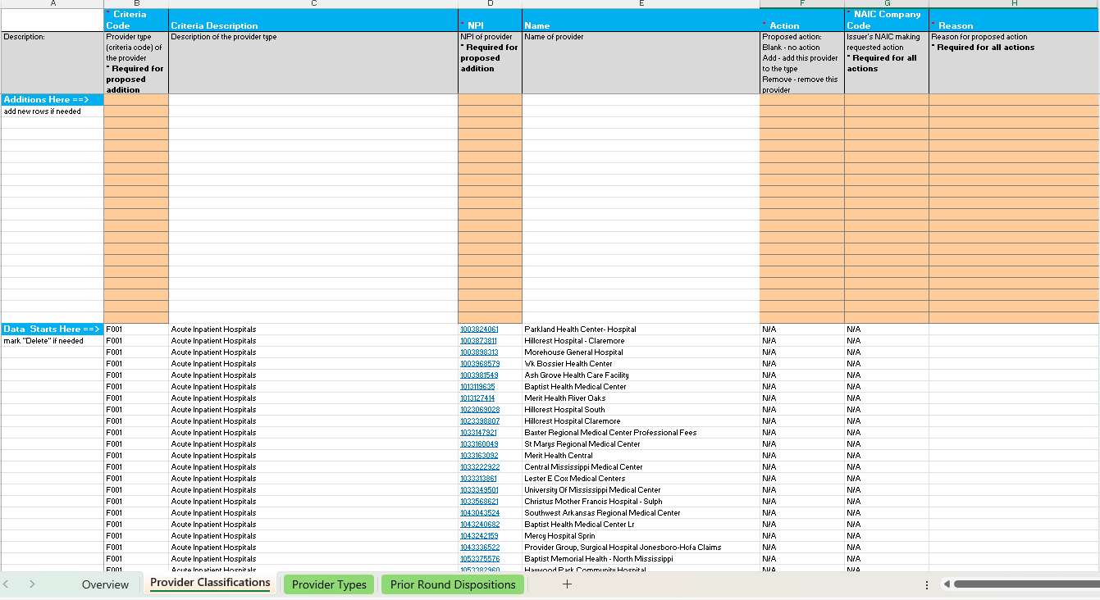
Mandatory columns for additions
How the “change suggestions” template initially looks like when downloaded
Additions section
Removals/Informational section
(Basically, the current PTNP)

Slide 23
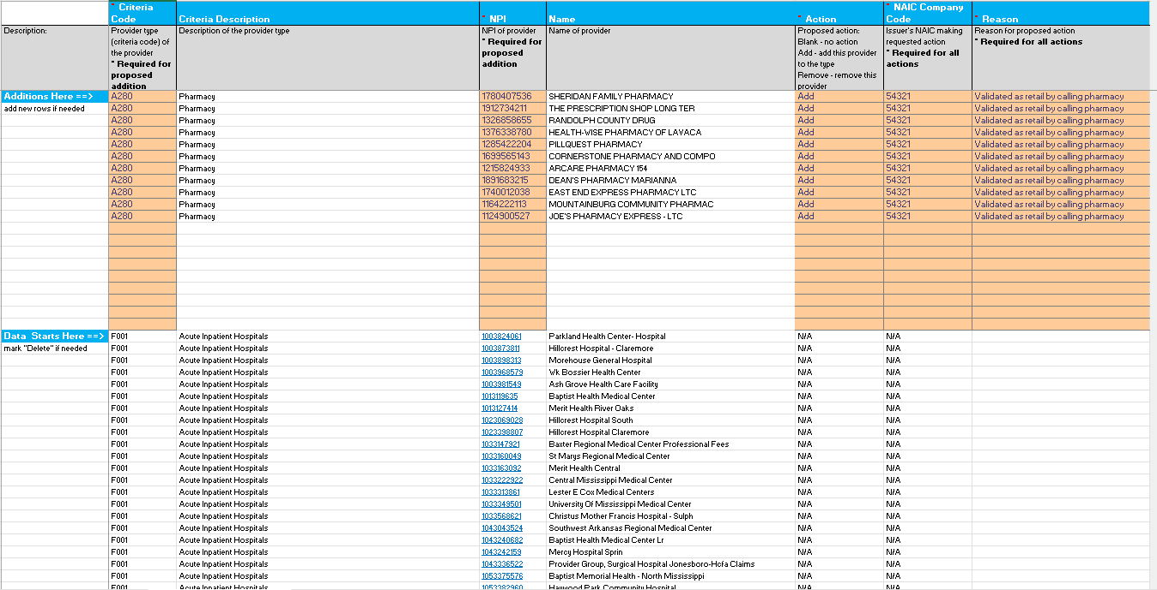
How the ADDITIONS section may look once a PBM/Issuer is done with the ADDITIONS

Slide 24
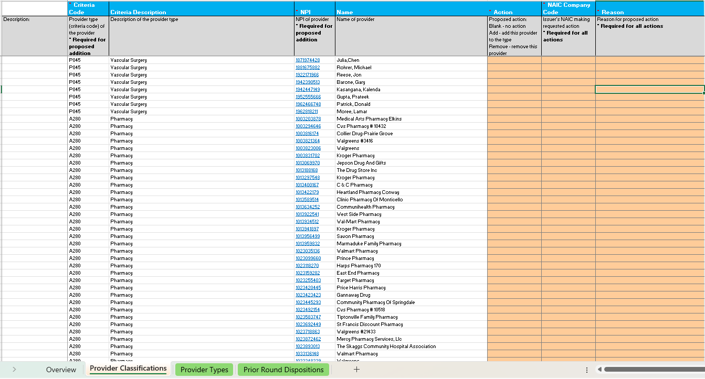
Pharmacies
How the removal section of the “change suggestions” template initially looks like when downloaded

Slide 25
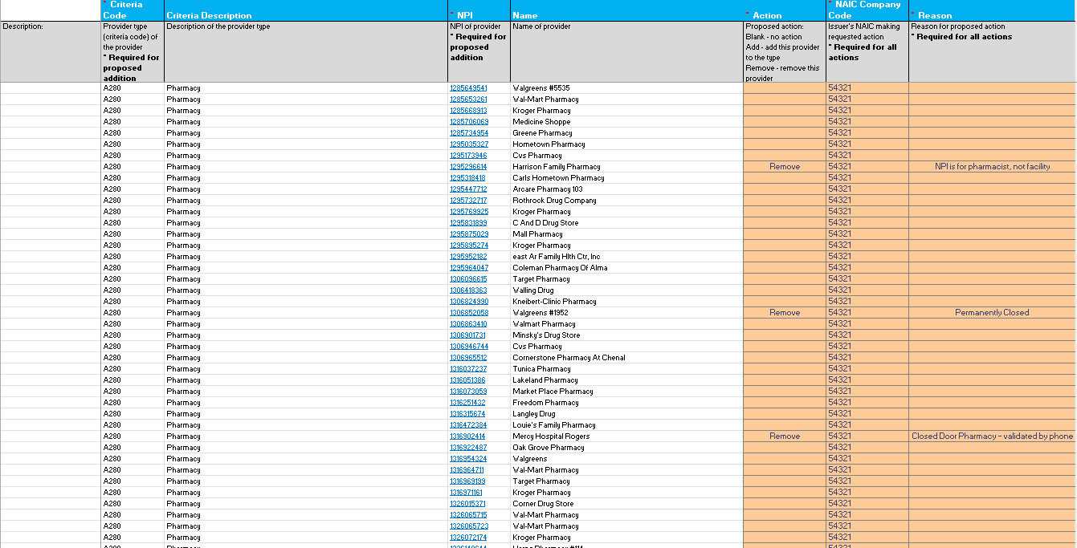
How the REMOVALS section may look like once a PBM/Issuer is done with REMOVALS
Mandatory columns for removals

Slide 26
Stage 2: “Votes Template”
The “Votes Template” is labelled <YYYY> Round <N> Industry Provider Type Addition-Deletion suggestions Template where <YYYY> is the applicable year and <N> refers to the PTNP round.
For example: 2026 Round 1 Industry Provider Type Addition-Deletion suggestions Template
Columns color coded in orange are essential for any DISAGREEMENT.
Unlike the “Suggestions Template”, the “Votes Template” has only one section – it is simply a consolidation of change suggestions from the prior stage.
Let’s look at a sample

Slide 27
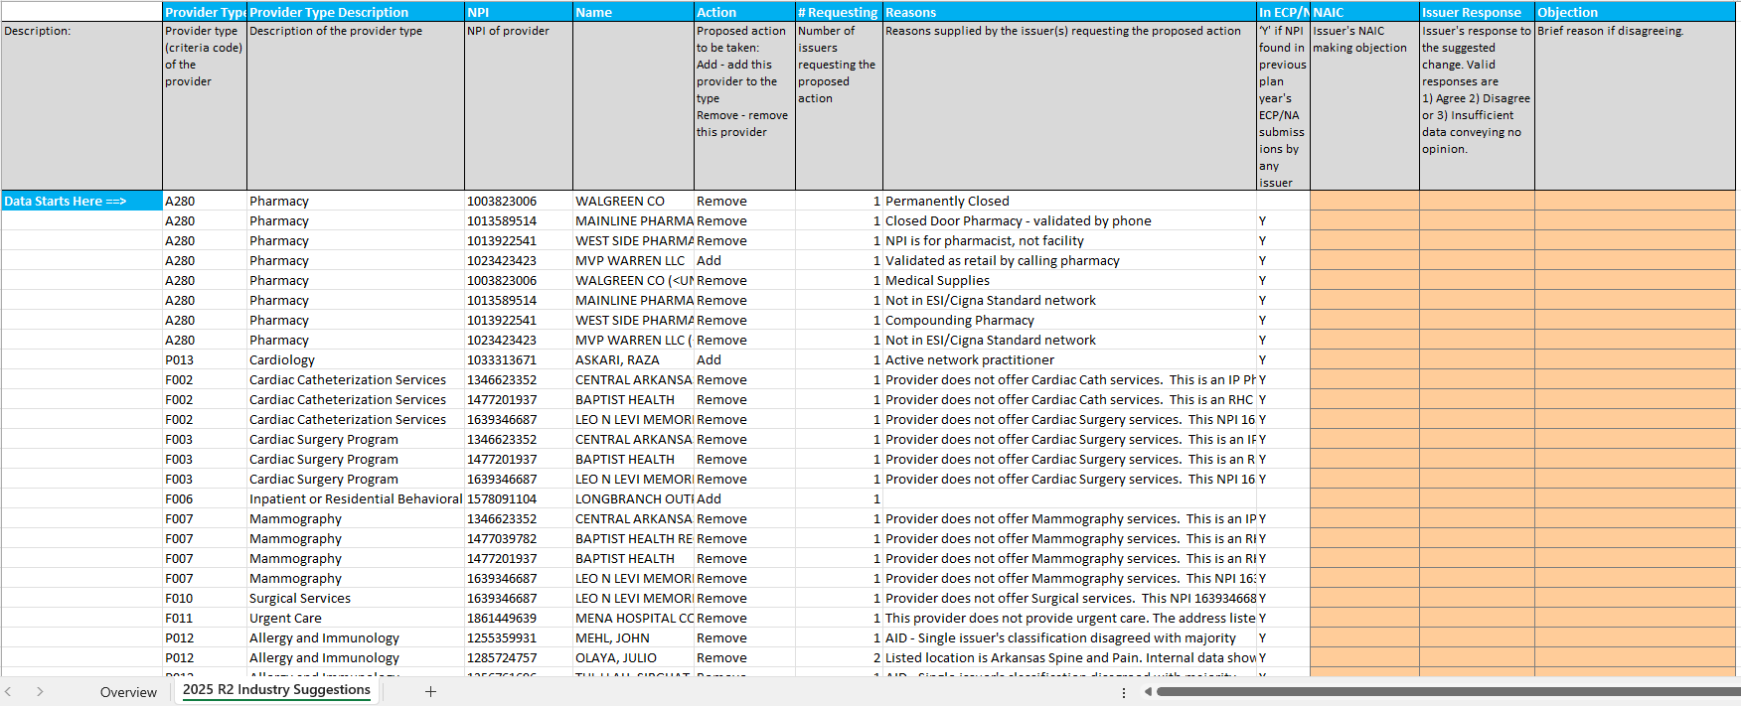
How the “vote” template initially looks like when downloaded
Suggest filtering for only “Remove” or “Add” at a time to avoid confusion when voting

Slide 28
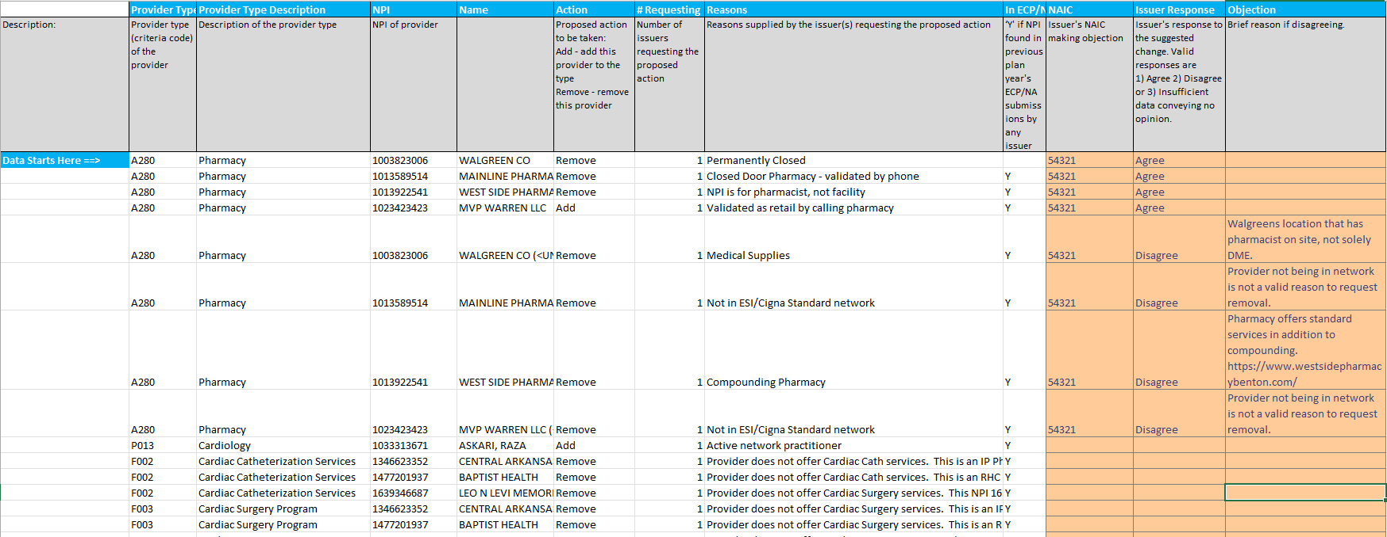
How the “votes templates” may look like once a PBM/Issuer is done with their votes
Note a “reason” provided for every disagreement

Slide 29
How? When? (cont’d)
The PTNP collaborative classification is facilitated by AID:
  For each change, AID makes a disposition based on vote counts and/or reason(s). Mostly on vote counts.
  Issuers always encouraged to provide the most evidentiary reason in a concise manner for change suggestions as well as votes.
  AID’s dispositions are transparent.
Agree
Agree
Disagree
Add Best Pharmacy?
Remove Druids Pharmacy?
Remove Marks Pharmacy?
Agree
Insurance Dept.
Votes
Issuers
Stage 2
Template

Slide 30
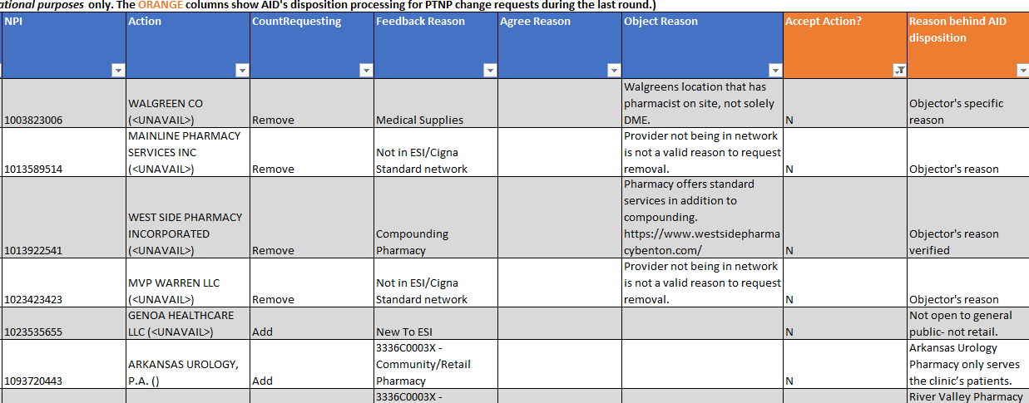
How? When? (cont’d)
Orange columns communicate AID’s Dispositions with transparency
The PTNP

Slide 31
The PTNP
  What?
  Who?
  Why?
  Where?
  How?
  When?

Slide 32

When? … do I engage in this process?
The PBM PTNP Review Process is a new 2026 document located at https://rhld.insurance.arkansas.gov/PBMRegulation that details how an insurer/PBM could engage in the PTNP process.
It is a step-by-step process document. Besides describing each process, it details the following associated with the process
  The accountable actor for the process.
  The inputs and outputs of the process, down to naming conventions.
  Location to get the inputs and deliver the outputs.
  Date when the inputs are available and outputs are due.
Let’s look at the process timeline with illustrations…
as of Jan 9, 2026, when this tutorial was made

Slide 33
PTNP maintenance timeline: 2026 Round 1
All details available in the PBM PTNP Review Process
Finalized Provider Type-NPI Pool (AID)
Color legend
AID artifact
Issuer artifact
Mar 16, 2026
Stage 1
Initial Provider Type NPI Pool (AID)
Feb 27, 2026
Votes by individual carriers (Issuers)
Dec1, 2025
Jan 30, 2026
Jan 15, 2026
Addition-Deletion Suggestions by individual carriers (Issuers)
Industry Provider Type Addition-Deletion suggestions (AID)
Stage 2

Slide 34





http://rhld.insurance.arkansas.gov/Default/NetworkAdequacy
2026 Round 1 Initial Provider Type-NPI Pool
(Available since December 1, 2025)
Add? Delete?
Blue Cross Experts
“20260115_83470_BCBS_Provider_Type_NPI_AddDelete.csv”
(Due Jan 15, 2026)
AID Secure FTP Server
Stage 1: “Suggestion for changes” stage using BCBS as an example

Slide 35


http://rhld.insurance.arkansas.gov/Default/NetworkAdequacy
“2026 Round 1 Industry Provider Type Addition-Deletion suggestions Template" (Expect Jan 30, 2026)
To agree or not to agree on this addition and that removal?
Ambetter Experts
“20260227_80799_Ambetter_ObjectionVote.csv”
(Due Feb 27, 2026)
AID Secure FTP Server
Stage 2: “Voting” stage using Ambetter as an example

Slide 36
The PTNP
  What?
  Who?
  Why?
  Where?
  How?
  When?
  Suggested strategy on
    Pharmacy validation
    PTNP engagement

Slide 37
Suggested pharmacy validation strategy.
The pharmacy list in the PTNP was first “seeded” from the NCPDP & NPPES database using a scoring system deemed to best determine a retail pharmacy, because neither database was accurate enough. This scoring system was done in complete transparency.
Henceforth, only the PTNP process would be used to update the pharmacy pool. We are currently in the second round of the PTNP process for the pharmacy provider type.
Going forward issuers/PBMs are advised NOT to add pharmacy(ies) into the PTNP list only because they are classified Community/Retail in either of the following databases:
    NPI Registry (NPPES data) or
    NCPDP database.
  Because otherwise it defeats the purpose of why pharmacies are back in the PTNP process – needing classification accuracy better than either of the databases.
Instead, take the additional step to verify directly with the pharmacy if they are Community/Retail. It’s a simple two question validation.

Slide 38
Suggested validation strategy (cont’d).
Vet pharmacies as Community/Retail. (Their contact number in the NPI Registry is mostly accurate)
Never ask a pharmacy if they are “Retail”. Local/State pharmacy boards may issue a retail license that does not align with Medicare’s interpretation of a Community/Retail pharmacy. Medicare’s interpretation is applicable in PBM regulation.
AID suggests asking the pharmacy two questions;
  Would you entertain anyone from the public walking into your pharmacy with a valid prescription?
  Do you carry generally the range of medications a Walgreens, Walmart Pharmacy or Kroger Pharmacy would?
  The answer to 1) and 2) needs to be “Yes”.

Slide 39
Suggested PTNP engagement strategy
During the Stage 1 “Suggestions” phase:
Don’t boil the ocean, reviewing thousands of pharmacies.
Use business triggers such as (but not limited to)
  Changes in the network
    New pharmacies: If missing in the PTNP, validate as retail & earmark for addition.
    Closed pharmacies: If existing in the PTNP, earmark for removal.
    Changed ownership: Earmark NPI under old management for removal & add NPI under new management for addition.
  Objections received:
    If OON Pharmacies close to or inside the deficient ZCTA is verified as not retail, earmark for removal
    If you have a pharmacy close to or inside the deficient ZCTA that is retail but not in the PTNP, earmark for addition.

Slide 40
Suggested PTNP engagement strategy (cont’d)
During the Stage 2 “Voting” phase:
Do vote on all pharmacy change suggestions.
There should not be many – you would not be boiling the ocean.

Slide 41


Questions?
Email
RHLD.DataOversight@arkansas.gov

Slide 42
Appendix: Samples of completed PTNP templates
Sample “Suggestions” template: https://rhld.insurance.arkansas.gov/Downloadables/PTNPProcessTutorialForPBM/200_DataSubmissionTemplates/100_SAMPLE_Suggestions_template.xlsx
Sample “Votes” template: https://rhld.insurance.arkansas.gov/Downloadables/PTNPProcessTutorialForPBM/200_DataSubmissionTemplates/200_SAMPLE_Votes_template.xlsx

